Slide 1
Costs of Emission Reduction
Estimates of total and marginal costs
Sensitivity of these costs
Feasibility of deep cuts
Distribution of costs
Negative costs

Slide 2
Lectures
Science
Scenarios & emission reduction options
Costs of emission reduction
Instruments for emission reduction
Impacts and adaptation
Economic impacts of climate change
Reading week
Climate and development
Optimal emission reduction
Discounting, uncertainty, equity
International environmental agreements

Slide 3
Costs of Emission Reduction
Estimates of total and marginal costs
Sensitivity of these costs
Feasibility of deep cuts
Distribution of costs
Negative costs

Slide 4
Abatement Costs
Abatement costs are real and positive
Without climate policy, emissions are free – with climate policy, emissions are costly
Alternatively, climate policy puts an additional constraint on the energy system – if the constraint bites, costs necessarily increase

Slide 7
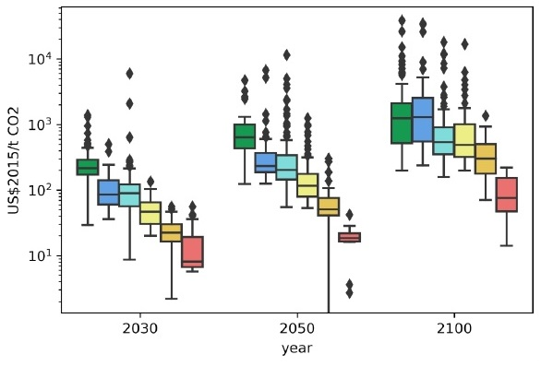

Slide 8
Gross world product: $80 trillion
If growth 3% per year, discount rate 5% per year, NPV = $3500 trillion

Slide 9
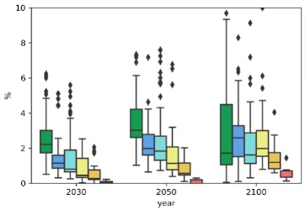

Slide 10
Abatement Costs -2
Abatement costs are higher if
There are fewer options to reduce emissions
The costs of emission reduction options are higher
The costs of emission reduction options fall more slowly over time
The rate of cost decline does not respond to climate policy
The economy is less responsive because elasticities are lower or because capital lasts longer

Slide 11
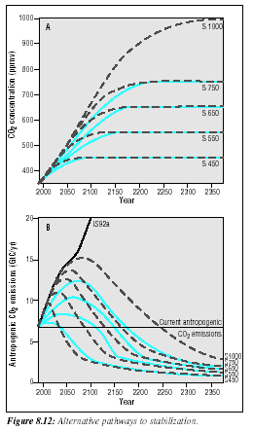
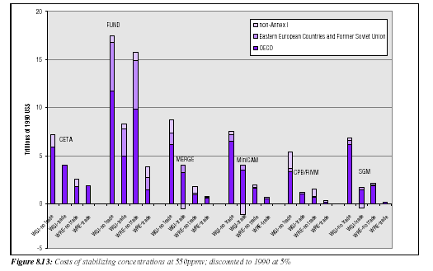
It is better to start slow because:
Capital stock turnover
Technological progress
Discount rate
Carbon cycle

Slide 12
Costs of Emission Reduction
Estimates of total and marginal costs
Sensitivity of these costs
Feasibility of deep cuts
Distribution of costs
Negative costs

Slide 13
Why so many missing values?

Slide 15
Peters Twitter 2019

Slide 16
Negative carbon energy
Burning fossil fuels (ancient biomass) emits carbon dioxide
... unless carbon is captured and stored
Growing biomass absorbs carbon dioxide, burning biomass emits carbon dioxide
... unless carbon is captured and stored

Slide 17
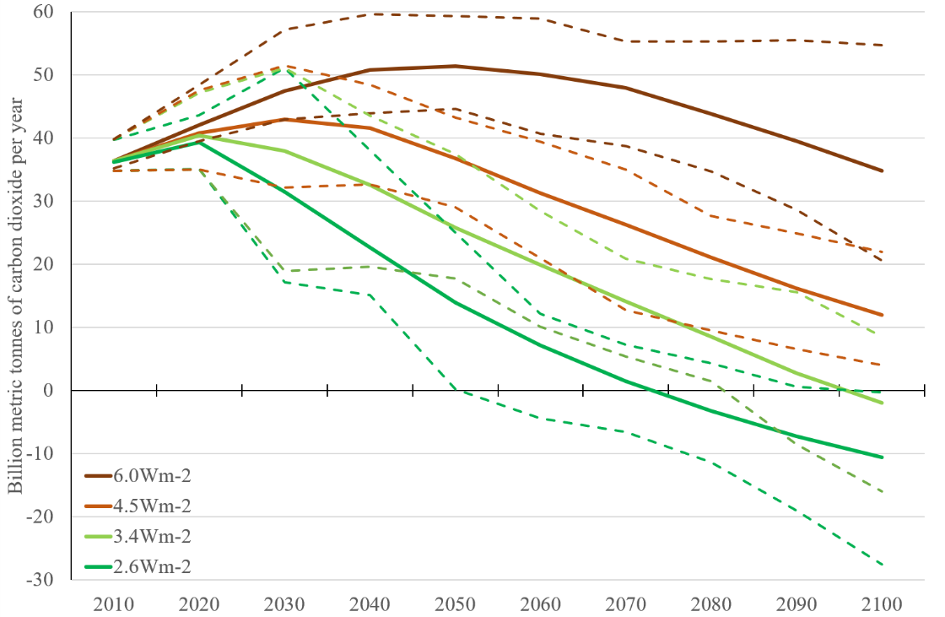
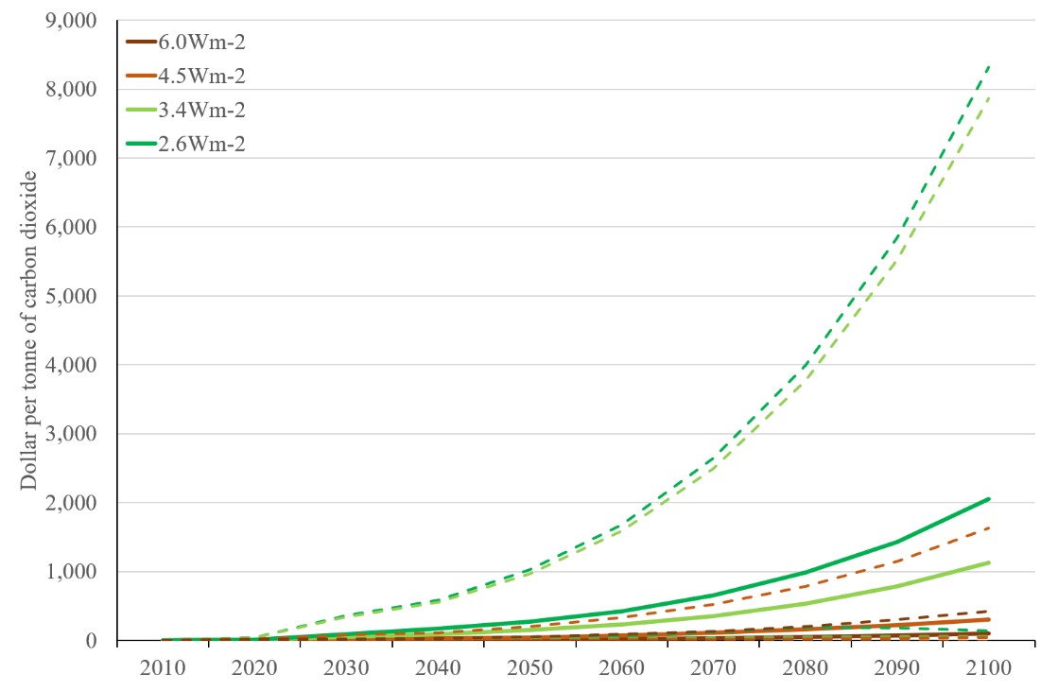
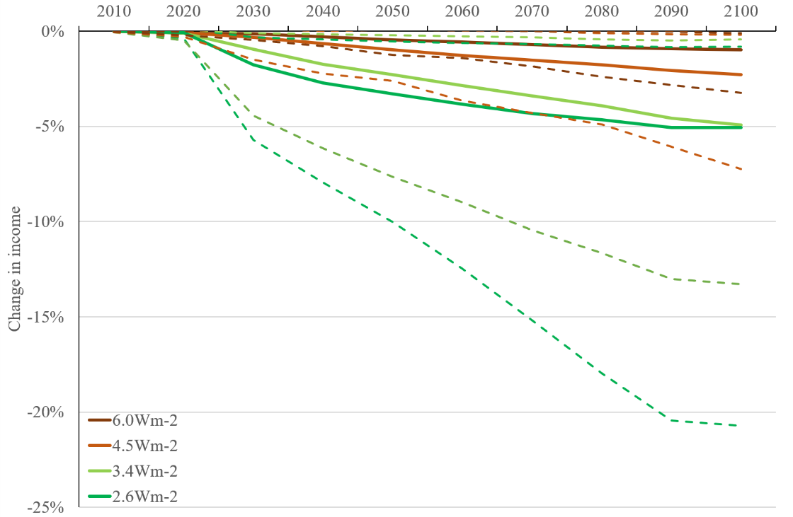
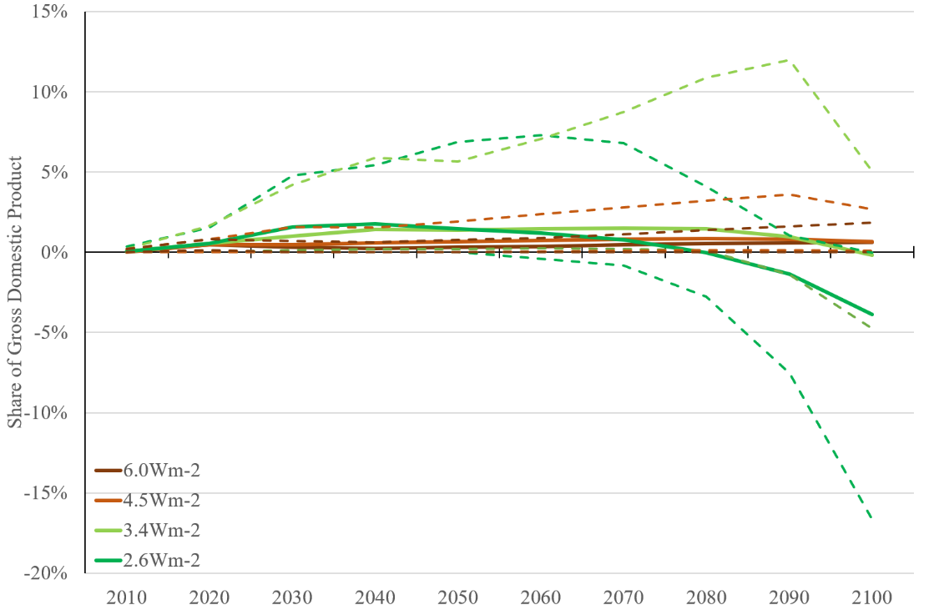

Slide 18
Costs of Emission Reduction
Estimates of total and marginal costs
Sensitivity of these costs
Feasibility of deep cuts
Distribution of costs
Negative costs

Slide 19
Incidence
Incidence is the somewhat peculiar word economists use for who pays
The average cost discussed above does tell us anything about the distribution of costs across society
Energy and food are the main sources of greenhouse gas emissions
Both are necessary goods

Slide 20
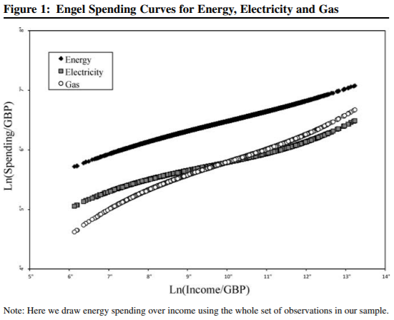

Slide 21
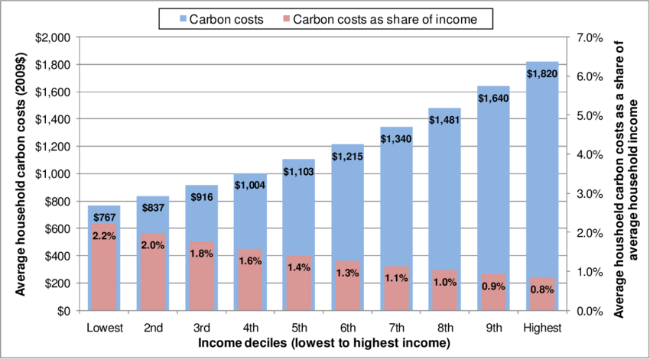

Slide 22
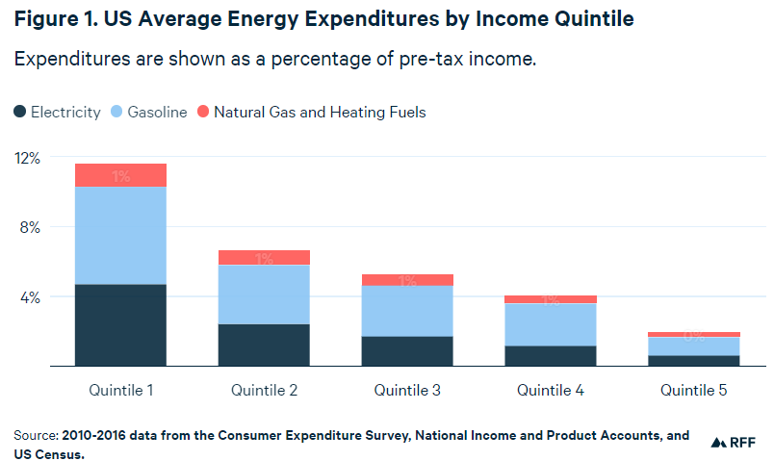

Slide 23
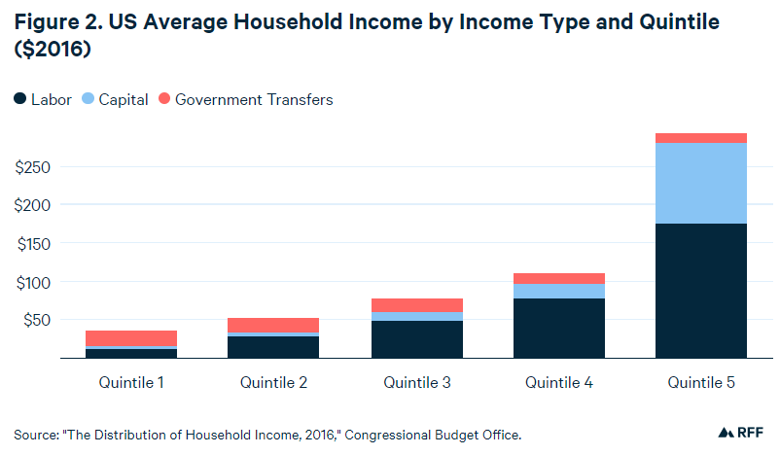

Slide 24
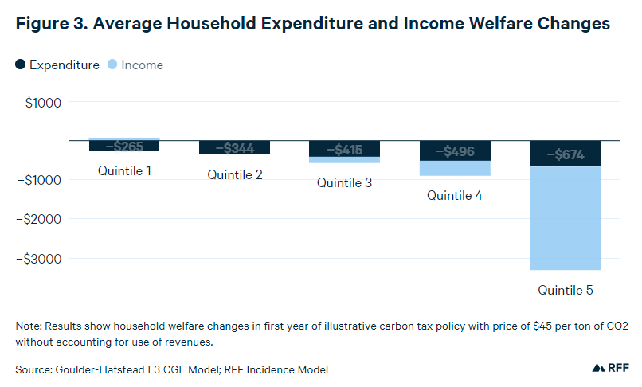

Slide 25
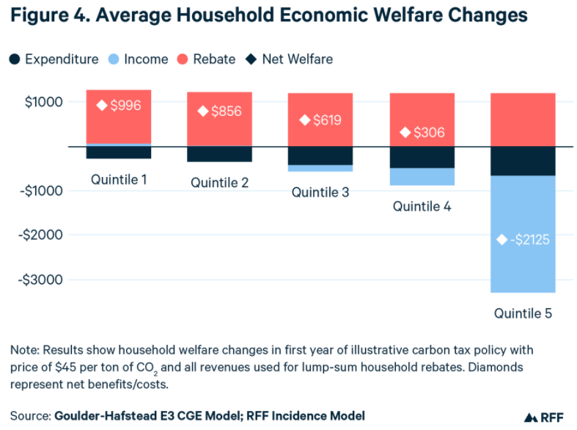

Slide 26
Costs of Emission Reduction
Estimates of total and marginal costs
Sensitivity of these costs
Feasibility of deep cuts
Distribution of costs
Negative costs

Slide 27
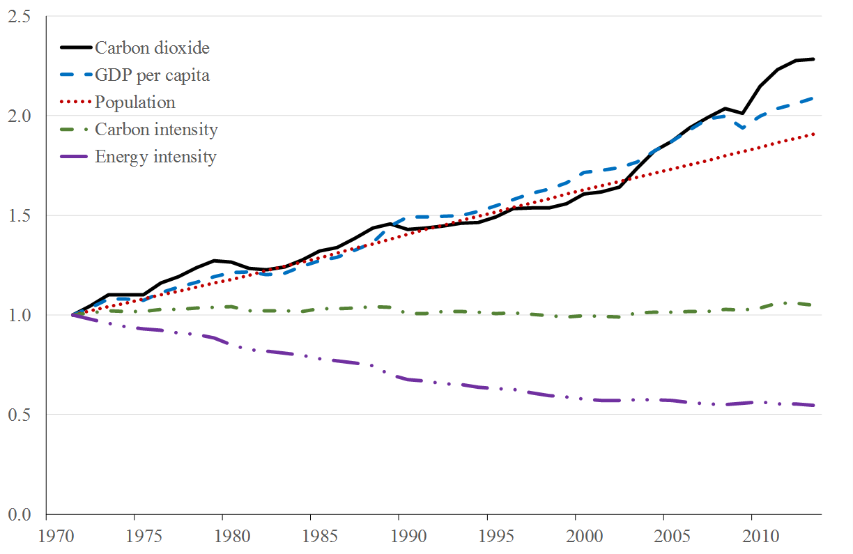
Negative Abatement Costs
There are claims that we could reduce emissions and save money
Most of this is bogus
Confusion of market forces and policy
Omission of hidden costs
Inappropriate discount rates

Slide 28
Negative Abatement Costs
Most economic models are optimisation models or assume perfect markets
If you’re in the optimum, any policy would increase costs
If the starting point is an imperfect market, costs may be positive or negative
Negative costs arise if climate policy reduces the overall market failure, or if the carbon tax reduces the overall distortion by the fiscal system

Slide 29
Distortions
A tax is more distortionary if
Tax base is narrower
Price elasticity is higher
Deadweight loss of a tax is roughly quadratic in the level of the tax
Raising the carbon tax distorts the economy, but probably not by that much
The carbon tax revenue can be used to reduce another tax – this would at least partly but maybe more than offset the costs of the carbon tax
In Europe, prime candidate would be labour taxes

Slide 30
Tax-interaction
A carbon tax reduces greenhouse gas emissions (first dividend)
The revenue of a carbon tax can be used to reduce other, more distortionary taxes (second dividend)
However, a carbon tax raises prices, reduces real wages and real returns on capital, and so the incentives to work and invest
These tax-interaction effects at least partly undo the double dividend

Slide 32
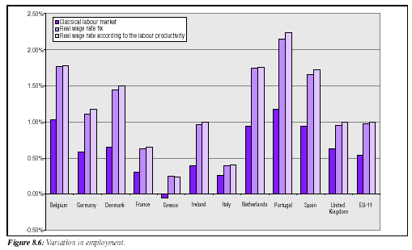

Slide 33
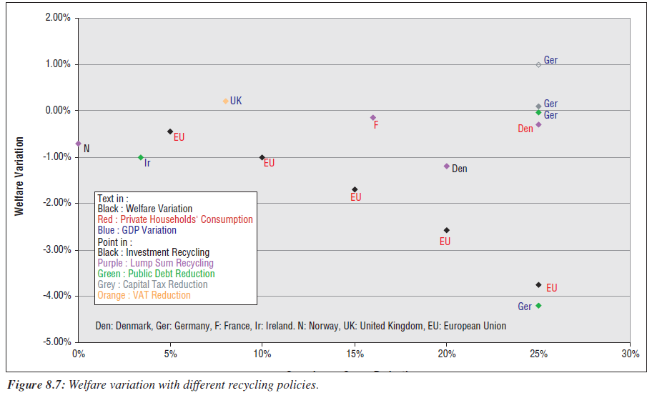

Slide 34
Recycling Taxes: Change in 2010 GDP due to a $40/tC tax
 | DRI | LINK | DGEM | Goul.
Lump sum | -0.58 | -0.46 | -0.62 | -0.24
Spend | -0.40 | -1.02 |  | -0.24
Pers. Inc. | -0.56 | -0.53 | -0.16 | -0.16
Corp. Inc. | 0.40 | -0.11 | 0.60 | -0.17
Payroll |  |  |  | -0.18
Pay – employee | -0.58 | -0.53
Pay – employer | 0.19 | -0.25
Inv. Cred. | 1.55 | 1.67 |  | 0.00

